Slide 1


Department of Computer Engineering
Project Presentation on:-
Drug Repurposing-
Drug-Target Interaction Prediction
Team 4A2
Omkar Ingole
Shreeyash Gaiki
Chaitreya Shrawankar
Deep Khaut
Project Guide
Dr. Dipak Wajgi

Slide 2
Drug-Target Interaction
Drug-Target Interactions (DTIs) refer to the biochemical interactions between a drug and its biological target, typically a protein.
These interactions are fundamental in determining the therapeutic effects of drugs. Understanding DTIs is crucial for drug discovery and repurposing.
Utilize machine learning to identify new therapeutic uses for existing drugs by analyzing large datasets of drug interactions, side effects, and clinical outcomes.
To reduce the high costs of drug discovery by narrowing down the pool of potential candidates early in the process.

Slide 3
Objective
Develop a machine learning model to predict potential interactions between drugs and human protein targets based on molecular fingerprints and sequence embeddings.
Collect and integrate diverse datasets, including drug properties, protein sequences, and experimental binding affinity data to train the model effectively.
Create a user-friendly interface or tool that allows researchers and healthcare professionals to input drug and protein data to receive interaction predictions and relevant insights.

Slide 4
Proposed Plan
Literature Review:
Study of multiple research papers to obtain the understanding of drug-target interaction.
Data Collection:
Identify and obtain datasets for drugs (e.g., DrugBank, ChEMBL), proteins (e.g., UniProt, PDB), and interaction data (e.g., BindingDB).
Data Preprocessing:
Clean and preprocess the collected data to remove duplicates and inconsistencies. Convert drug structures to molecular fingerprints and protein sequences to embeddings for use in the model.
Model Development:
Choose appropriate machine learning algorithms (e.g., Random Forest, Support Vector Machines, Neural Networks) to develop the predictive model.

Slide 5
Analysis & Design
For Drugs:
The SMILES string is used to compute a molecular fingerprint (usually a bit-vector of fixed length like 1024 bits) using tools like RDKit.
For Proteins:
The amino acid sequence is fed into a pre-trained model like ProtVec or protein2vec, which converts it into a dense embedding (e.g., a 100-dimensional vector).
This data will be the input for your machine learning model to predict drug-target interactions.
For each drug-target pair, the molecular fingerprint of the drug and the sequence embedding of the protein are concatenated into a single feature vector.
This feature vector is fed into the machine learning model.

Slide 6
Analysis & Design(contd.)
Target Variable (Binding Affinity):
The model’s objective is to predict the binding affinity (e.g., Ki, IC50, Kd) between the drug and the target protein.
The interaction database provides these target values, allowing the model to learn the relationship between the input features and the binding strength.

Slide 7
System Design
The implemented model is a Multi-Layer Perceptron (MLP) designed to predict drug- target
binding affinities using 1D sequence representations of drugs and proteins.
The data preprocessing involves encoding drug molecules through SMILES (Simplified Molecular Input Line Entry System) strings and protein sequences using embeddings,ensuring the model receives meaningful input features

Slide 8
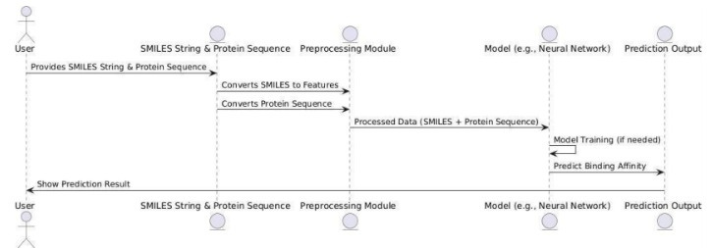
Sequence Diagram

Slide 9
Implementation Module
Drug Example: Aspirin
SMILES Notation: CC(=O)OC1=CC=CC=C1C(=O)O
1. Input: SMILES notation for Aspirin: `CC(=O)OC1=CC=CC=C1C(=O)O`.
2. Convert SMILES to Molecular Structure: Use the RDKit library to transform the SMILES notation into a molecular structure.
3. Generate Fingerprint: Instead of Moran Fingerprints, use ECFP (Extended Connectivity Fingerprints) or MACCS keys.
4. Reason for Alternatives: Morgan fingerprints are specialized and complex, so ECFP or MACCS are used as simpler proxies for structural information in binary vector format.
5. Output: A binary fingerprint vector representing the molecular structure.

Slide 10
Implementation Module
1. Input: Protein sequence for P53: `MFVRITAPSTEGVSMMEMETQ...` (shortened for demonstration).
2. Convert Sequence to Embedding: Use a pre-trained language model like ProtBERT or ESM-2 to transform the amino acid sequence into an embedded vector.
3. Embedding Purpose: The model converts the sequence into a dense, fixed-length vector that captures the protein's biochemical and biophysical properties.
4. Output: A fixed-length embedding vector representing the protein's sequence and properties.

Slide 11
Implementation Module
Model Output: Predicting Interaction Strength
The model's output will be a single value indicating the interaction strength or binding affinity between the drug and protein target.
Common metrics include:
Binding Affinity (Ki): Lower values indicate stronger binding.
IC50 (Half-Maximal Inhibitory Concentration): Lower values indicate a more potent interaction.
Example Output for DTI Model
Suppose the model is predicting interaction strength for Aspirin with P53 protein:
Combined Input Vector: [0, 1, 0, ..., 0.12, -0.35, 0.78, ..., 0.09]
Model Output: 0.85 (Strong Interaction)
The model can be evaluated using standard metrics like Mean Squared Error (MSE) for regression tasks or Accuracy / F1-Score for classification tasks, depending on the type of DTI prediction.

Slide 12
Implementation Module
Drug SMILES
CC(=O)OC1=CC=C...
Length: 1024
Molecular Fingerprint
[0, 1, 1, 0, 0, 1, 1, 0, 0, ....., 0, 0]
Length: 2048
[0, 1, 1, 0, 0, 1, 1, 0, 0, ....-0.00 -0.045 0.078 -0.092]
Coverts to
Combines to
Protein Sequence
MFVRITAPSTEGVS....
Length: 1024
Embedded Sequence
[-0.094 -0.092 ... -0.00 -0.045 0.078]
Deep Learning
Model
Binding Database
Compares to
0.87
Binding Affinity
Value

Slide 13
Dataset
The Davis dataset contains selectivity assays of the kinase protein family and the relevant inhibitorswith their respective dissociation constant (Kd) values.
It comprises interactions of 442 proteins and68 ligands so in total it contains 30,056 interactions.
The compound SMILES strings of the Davis datasetwere extracted from the Pubchemcompound database basedon their Pubchem CIDs.
For the compounds of the Davis dataset, the maximum lengthof a SMILES is 103, while the averagelength is equalto 64.
Both SMILES and protein sequences have varying lengths.
Hence, in order to create an effective representation form, we decided on fixed maximum lengths of 85 for SMILES and 1200 for protein sequences for Davis.

Slide 14
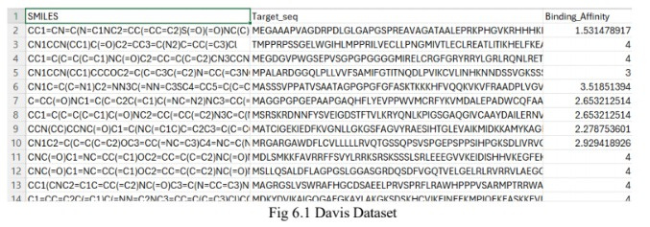
Dataset

Slide 15
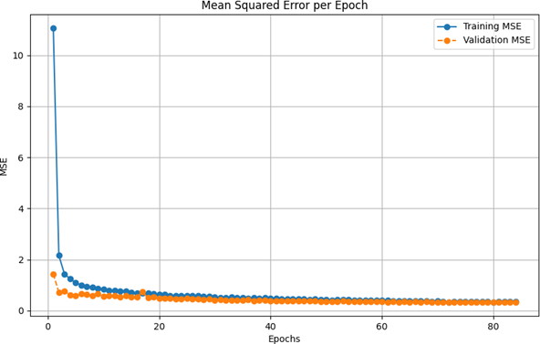
Performance Evaluation
The graph illustrates the trend of the Mean Squared Error (MSE) over training epochs for both the training and validation datasets. This pattern is representative of a well-converging model and is indicative of effective learning.
MSE Graph

Slide 16
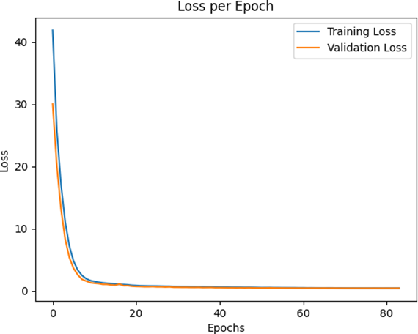
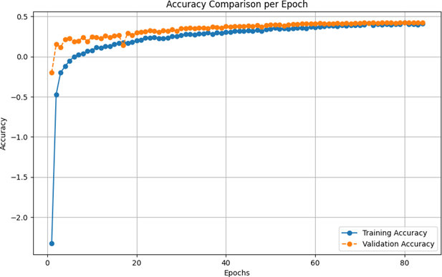
Performance Evaluation
Loss per Epoch Graph
Accuracy per Epoch Graph

Slide 17
Conclusion
This project successfully implemented a Multi-Layer Perceptron (MLP) model for predicting drug-target binding affinities usingone-dimensional representations of drugs (SMILESstrings) and proteins (aminoacid sequences) by transforming theseinputs into numerical vectors through feature extraction techniques, the model effectively captured complex biochemical relationships.
The project not only providesa foundation for faster and cost-effective drug discovery but also underscores the potential of integrating machine learning into pharmaceutical research workflows.
By leveraging computational tools, researchers can significantly accelerate the identification of promising drug candidates, especially in addressing emerging diseases or optimizing existing drugs.

Slide 18
References
1. Hakime Ozturk, Arzucan Ozgur and Elif Ozkirimli, “DeepDTA: deep drug–target binding affinity prediction,” Department of Computer Engineering and Department of Chemical Engineering, Bogazici University, Istanbul 34342, Turkey.
2. Kexin Huang, Tianfan Fu, Lucas M Glass, Marinka Zitnik, Cao Xiao, Jimeng Sun, “DeepPurpose: a deep learning library for drug–target interaction prediction Bioinformatics, Volume 36, Issue 22-23, December 2020, Pages 5545–5547.
3. Tian,K. et al. (2015) Boosting compound–protein interaction prediction by deep learning. In: 2015 IEEE International Conference on Bioinformatics and Biomedicine (BIBM), Washington, DC, USA. IEEE, pp. 29–34.
4. Xing Chen, Chenggang Clarence Yan, Xiaotian Zhang, Xu Zhang, Feng Dai, Jian Yin, Yongdong Zhang, “Drug–target interaction prediction: databases, web servers and computational models,” Briefings in Bioinformatics, Volume 17, Issue 4, July 2016, Pages 696–712.
5. Tudor I. Oprea, Julie E. Bauman, Cristian G. Bologa, Tione Buranda, “Drug repurposing from an academic perspective.” Christopher A. Lipinski – Scientific Advisor, Melior Discovery, Waterford, CT 06385-4122, USA.

Slide 19
References
6. Davis dataset for drug-target interaction prediction Available at: https://github.com/dingyan20/Davis-Dataset-for-DTA-Prediction
7. Drug-target interaction prediction based on protein features, using wrapper feature selection by Hanegame Abbasi Mesrabadi, Karim Faez & Jamshid Pirgazi.
8. How to approach machine learning based prediction of drug/compound-target interactions by Heval Atas Guvenilir & Tunca Dogan.
9. Machine learningapproaches and databases for prediction of drug–target interaction: a survey paperby Maryam Bagherian, Elyas Sabeti, Kai Wang, MaureenA Sartor, Zaneta Nikolovska-Coleska, Kayvan Najarian.

Slide 20
Thank You

